Slide 1
EDGE DETECTION
Haobo Chen
Ni Kang
Haoming Zhang

Slide 2
Introduction of Project and Team
What is it and what does it do
Why and where would our design be useful
Main goals and constraints of the project

Slide 3
What is it and what does it do
Edge detection is a basic problem for image processing and computer visualization, whose aim is to denote the points which change obviously in digital image. The obvious changes in image properties usually reflect the property’s important events and changes, which includes: discontinuity in depth, discontinuity on surface, the changes in matter properties and the brightness change in a specific scenario. Image edge detection drastically decreases the number of data and eliminates the irrelevant information which keeps the important properties of the image structure.

Slide 4
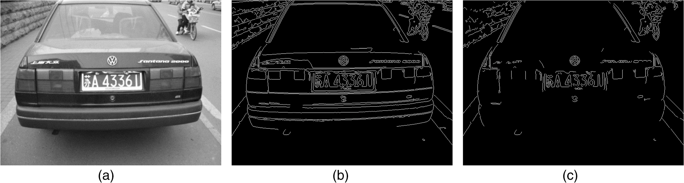
Notes:
This is an example of the edge detection. The first image is the original one, and the other twos are the results of the edge detection applied with different thresholds. As seen from the image, the relevant information is the car plate number, and the car plate number in the image has significant color difference from the environment, so that it can be detected by the edge detection.

Slide 5
Why and where would our design be useful
Edge detection could be really useful in a lot of aspects in life. As seen in the picture on the previous slide, it can be used to detect the car plate number. Detecting the car plate number from a diagram is a useful application in China nowadays since we have surveillance cameras at almost every main road and crossroad. Also, it can be used as face detection. After the edge detection, the detected face can be sent to other algorithms and to be used in a lot of application like the new iPhoneX’s face ID.

Slide 6
Main goals and constraints of the project
Main goal: being able to produce a edge detector for images, and the process time should be approximately 1s.
Constraints: Area
Delay/Clock Rate
Notes:
Since we are doing image processing, so it would require processing a lot of data. Processing large amount of data would result in either large area of the chip or long time to process. So that we can only think of a way in the middle, which will be introduced later. Also, the algorithm we will be using, which are Gaussian blur and Sobel filter, requires a lot of gates to achieve the corresponding result, which also increases a great amount of area of the chip. So that the area of the chip we are going to produce will be kind of large. Since we would use a lot of gates to do the calculation, the propagation delay would be kind of long. If we want to limit the time of processing the image, we would want to use a fast clock. However, if the clock is fast, the propagation delay would be longer than the clock cycle. And the solution to this is that we are going to add some wait state to wait until the calculation is done.

Slide 7
System View of Project
System level diagrams
High-level view of used interfaces & standards

Slide 8
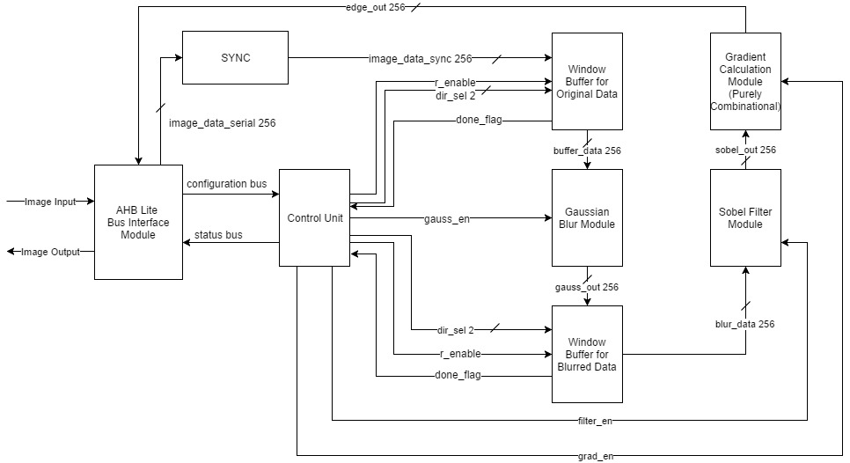
System level diagrams
Notes:
As shown above, our goal is to produce an image with black background white edges. This is the top level system diagram of the edge detector. The CPU will give AHB lite the address of the image data in the RAM and dimensions of the image. These data will be stored directly in AHB standard slave for faster access to the data. After getting the configuration data from the CPU, AHB bus will send them to the control unit for further operation. The control unit will be controlling the entire operation of the edge detecting process. The process flow will be performed with pipelining so that the clock cycles needed for waiting can be minimized. In our design, the only sequential logic block are the window buffers. If we make the module scalable, we can use the same logic for the buffers. Although all other blocks are purely combinational, it is necessary to have a enable signal for each block for the controller to keep track of the workflow. After the controller receives the 8x8 pixel block into the window buffer, it will enable the gaussian blur module. Since the gaussian blur is purely combinational and it takes some time to implement. The controller will hold the r_enabe of the second window buffer until the time requirement is met. The gaussian module will produce a 6x6 blurred pixel block and send the data to the next window buffer. The sobel filter will read the data from the second buffer and perform calculations on the data. Two 4x4 matrix will be produced by the sobel filter. Again this requires time and the control unit won’t enable the next block until the requirement is met. The last block is gradient calculation. the final image data will be produced by this block. The control unit will communicate with AHB Lite to read from the gradient module and send the final data to CPU.

Slide 9
High-level view of used interfaces & standards
Things acquired from users: the image needed to be filtered and the size of the image
Things out: the image filtered

Slide 10
Hardware Usage
Hardware interface requirements
AHB Lite Standard Slave
a. 256-bit data bus
b. Read and Write Transfers
c. Burst Transfers Supported
d. Pipelined Transfers
e. 3-bit, 8 word-address namespace (0x000 → 0x007)
Notes:
We will utilize 256 bit bandwidth for data transfer since image data is very large. The burst transfer mode of AHB lite will also be utilized for the same reason.

Slide 11
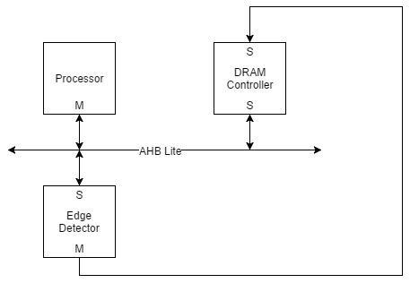
Hardware Usage Diagram
Notes:
In our design only 3 hardwares are utilized. The Processor is the main master that will control AHB Lite. AHB will communicate with our edge detector. However, only the edge detector knows when and where to access data from the memory. This resulting that it will act as a sublevel master and control the RAM directly.

Slide 12
Architecture of the design
Top-Level Diagram
Roles of Top-level blocks
Top-level block interactions
Operational flow at the top-level

Slide 13
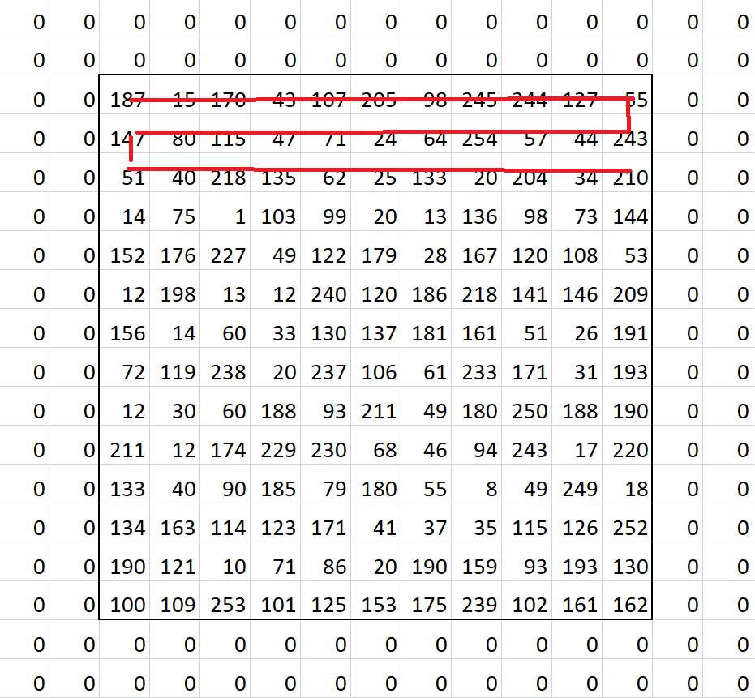
Role of Window Buffer Module
Store intermediate data
Notes:
The window buffer module is the only sequential logic module in the entire design. The main function of this block is to store the intermediate data for further processing. The window buffer rolls in a zigzagging manner as shown above. For the edge cases that it is at the borders. The slots outside the border will be stored as 0 so that they doesn’t interfere with further calculations. For the calculation of each pixel, for both gaussian blur and sobel filter, it will require the data of 9 pixel surrounding it including itself. Which means when we update the contents of the buffer, we will need some of the previous data. That’s where the shift register come in handy, the require data from the previous iteration will not be read again from RAM or the previous block, instead they will be shifted from existing data in the buffer because shifting is just wiring and doesn’t need any circuit. After the shifting process, the new data will fill the rest spaces.

Slide 14
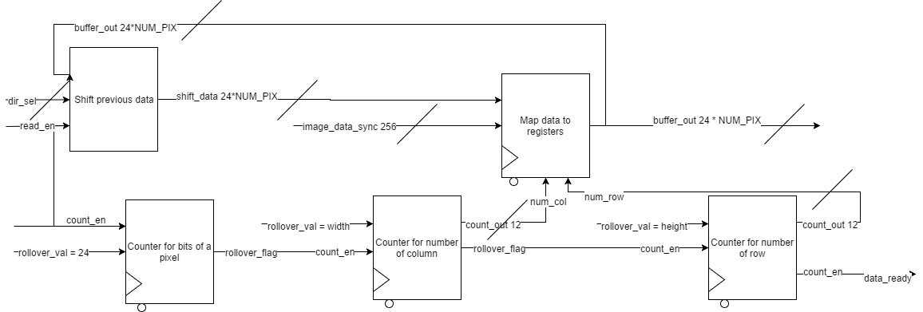
Window Buffer Module
Notes:
This is the block diagram for the window buffer module. We will make this block scalable so that it is easier to use. The idea of edge detection using Sobel filter is easy in terms of mathematics as you will see in the next few session, the difficult part is how to manipulate the data. The first window buffer will read data from the RAM and produce an 8x8 matrix for further processing. The second window buffer will read data from gaussian blur module and store a 6x6 matrix for sobel filter. We choose the dimension of 8x8 for the first buffer because we want to make the time for data transfer shorter. The window buffer will have 3 counters in sequence to keep track of the data transfer. The first counter is to count the number of bits in a pixel, the rollover_flag will be asserted each time when a pixel is processed. The second counter is to keep track of the column index of the matrix and the third counter is for keeping track of the row index of the matrix. The most important part is to store data. We will try to manipulate data so that the time can be minimized as the combinational logic already takes a long time. Every time before new data is transferred in to the buffer. The shift register will shift previous data from the feedback loop into the right position and clear out the space for incoming new data. The shift direction will be determined by the dir_sel signal. The shift displacement will be determined as a constant since the window buffer will be made scalable.

Slide 15
Gaussian Filter Module
The Gaussian Blur module is a pure combinational block that will take in the data(8*8*24 bits) output from window buffer module and execute the value by selecting 3*3 pixel boxes, adding the 9 pixels together, and then divided by 9 to get the average value of the middle pixel. All of these calculations are done parallely. After finishing all calculations, it will and pass a 6*6 pixels to the next window buffer.

Slide 16
Sobel Filter Module
This is a purely combinational block, which will calculate two values for each pixel. The input of this module is a 4*4 pixel array, and the output should be two arrays calculated by the middle 2*2 pixels. One of the output arrays should be the horizontally calculated value of the 4 pixels(x), and the other one is the vertically calculated value of the 4 pixels(y). And the diagrams of the specific algorithm are shown as follow:
-1
0
1
-1 | 0 | 1
Notes:
Sobel Filter Module is a purely combinational block. The main input of the block is a 4*4 pixel array, and the main output is two 1-D arrays with each 4 elements inside of it. The first array is represented by x, and the second one is represented by y. The four elements are the calculation results of the middle 2*2 pixel inside of the 4*4 one, and the x is horizontally calculated, y is vertically calculated. As the model shown, the horizontal one is calculated by the right pixel minus the left pixel, and the vertical one is calculated by the downward one minus the upward one. So that if we have a 4*4 as input, we can only get result of the middle 2*2.

Slide 17
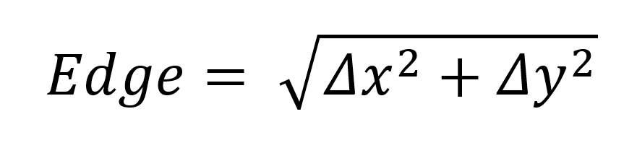

Gradient Calculation Module
After the sobel filter finishes the calculation, a group of gradients is found(x and y). Then, the Pythagorean theorem is applied to the two gradient vectors. Since it is possible to have a negative gradient, it is necessary to take the absolute values of them. And then, we need to calculate a value to compare it with a threshold value which will be determined later during the actual ‘doing’ process. And the value will be calculated by the formula as follow:
Since it’s difficult to deal with the square root, so we change it as follow:

Slide 18
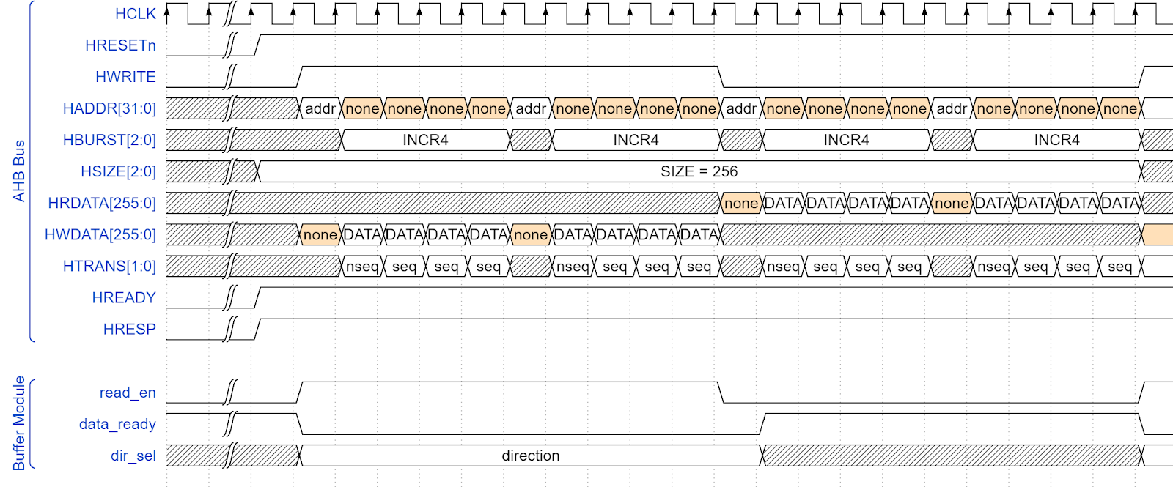
Top level block interactions
Notes:
The only interaction between blocks that needs to be handled with care is the data transfer for the buffer. As we can see in the example above, we use the 4 beat incrementing burst mode of AHB Lite for both reading and writing. The read_en signal of the buffer will be enabled at the same time HWRITE is enabled.

Slide 19
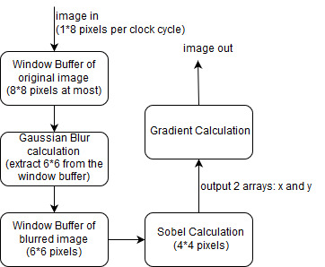
Operational flow at the top-level

Slide 20
Current/projected implementation
At the very beginning, we thought that every one of our calculation block should be sequential since we didn’t want data to be parallel in. But afterwards, we realized that registers take up too much spaces for image processing, so we decided that we would use purely combinational block since that would only use wires to transfer data, which does not take too much spaces. So that the only complicated problem now is the window buffers since we want the logic in the combinational blocks to be as simple as possible. Although there are two window buffers, they are doing the same task, so we just need one algorithm and replace the parameters inside of it.

Slide 21
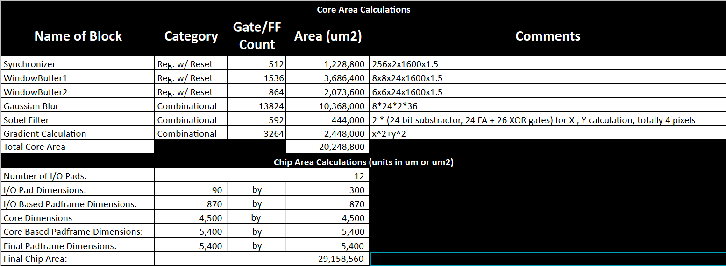
Area Budget Summary

Slide 22
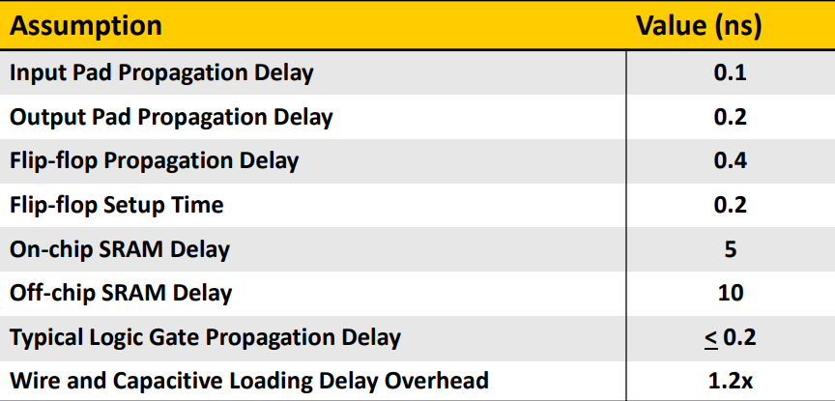
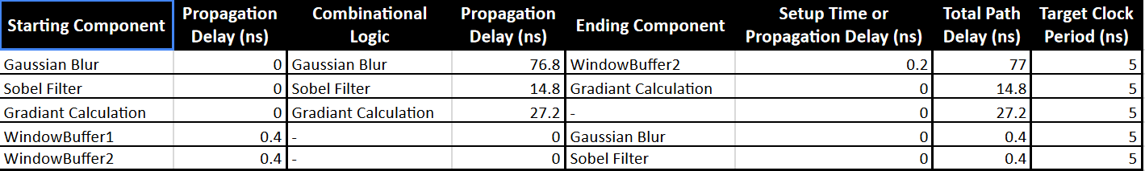
Propagation Delay Summary

Slide 23
Remaining Timeline
Week of Apr 2nd: Write code of window buffer and testbench
Week of Apr 9th: Write code of gaussian blur and testbench
Week of Apr 16th: Write code of Sobel and Gradient and testbench
Week of Apr 23rd: Write the final report and prepare the presentation

Slide 24
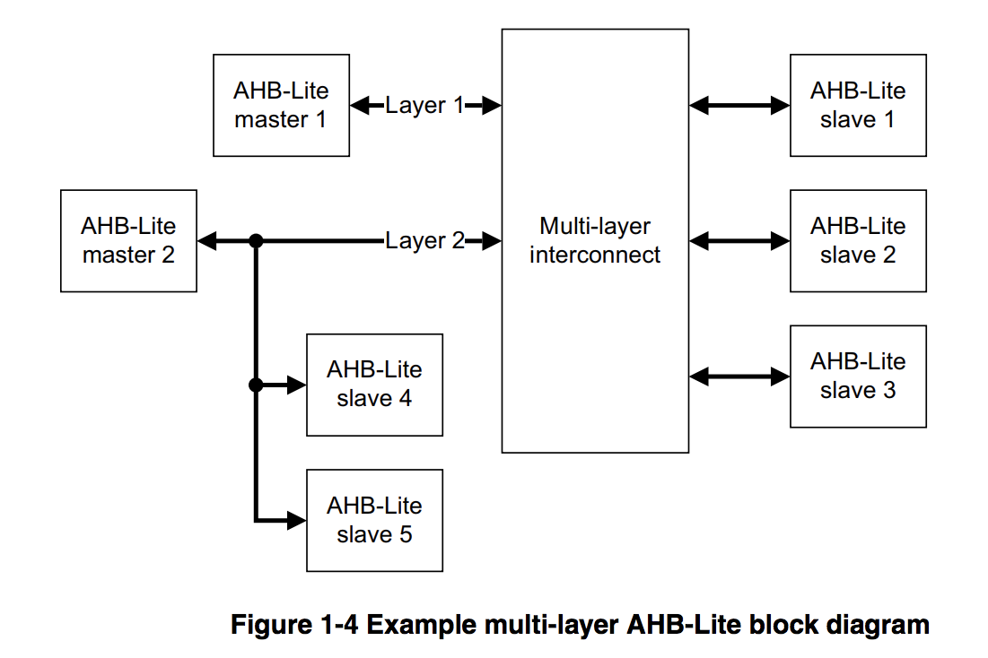
Excerpt

